Slide 1
Multi-media Security An attack of MRSE
網媒二 r01944007 簡伯宇
資工三 b00902064 宋昊恩

Slide 2
Outline
Intuitive method
Why is it not safe?
What else can we do?
Introduction to MRSE
Attack upon MRSE
Purpose
Method
Demo
Conclusion

Slide 3
Intuitive method

Slide 4
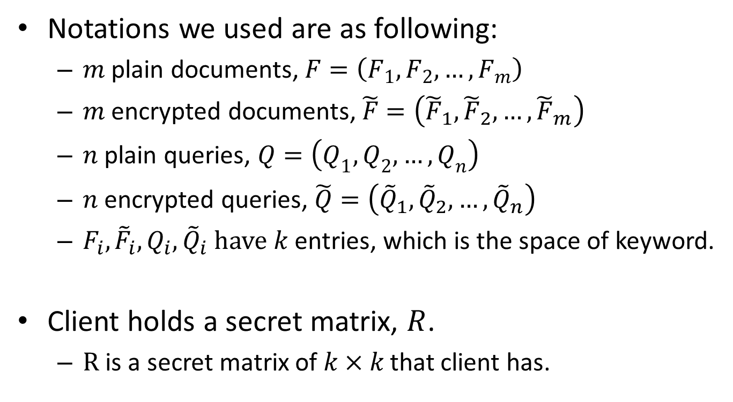
Intuitive method
Notations we used are as following:
$m$ plain documents, $F=\left(F_{1},F_{2},…,F_{m}\right)$
$m$ encrypted documents, $\tilde{F}=\left({\tilde{F}}_{1},{\tilde{F}}_{2},…,{\tilde{F}}_{m}\right)$
$n$ plain queries, $Q=\left(Q_{1},Q_{2},…,Q_{n}\right)$
$n$ encrypted queries, $\tilde{Q}=\left({\tilde{Q}}_{1},{\tilde{Q}}_{2},…,{\tilde{Q}}_{n}\right)$
$F_{i},{\tilde{F}}_{i},Q_{i},{\tilde{Q}}_{i}$have $k$ entries, which is the space of keyword.
Client holds a secret matrix, $R$.
$R$ is a secret matrix of $k×k$that client has.

Slide 5
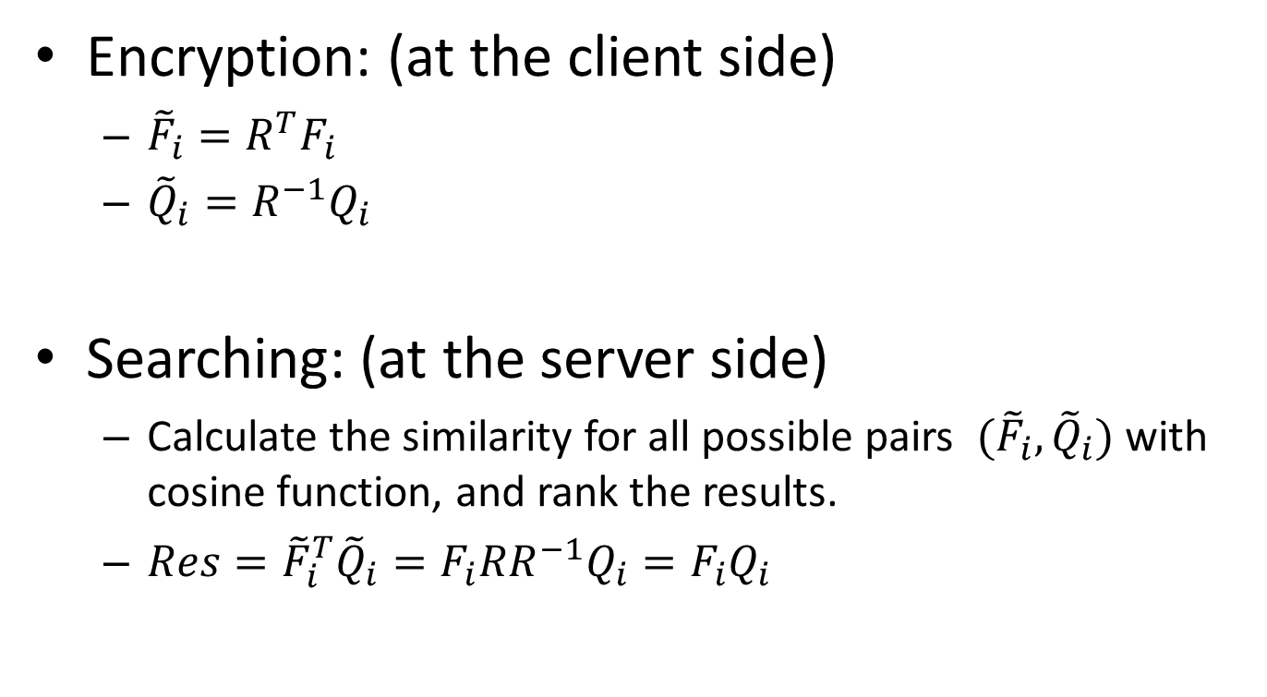
Intuitive method
Encryption: (at the client side)
${\tilde{F}}_{i}=R^{T}F_{i}$
${\tilde{Q}}_{i}=R^{−1}Q_{i}$
Searching: (at the server side)
Calculate the similarity for all possible pairs $({\tilde{F}}_{i},{\tilde{Q}}_{i})$ with cosine function, and rank the results.
$Res={\tilde{F}}_{i}^{T}{\tilde{Q}}_{i}=F_{i}RR^{−1}Q_{i}=F_{i}Q_{i}$

Slide 6
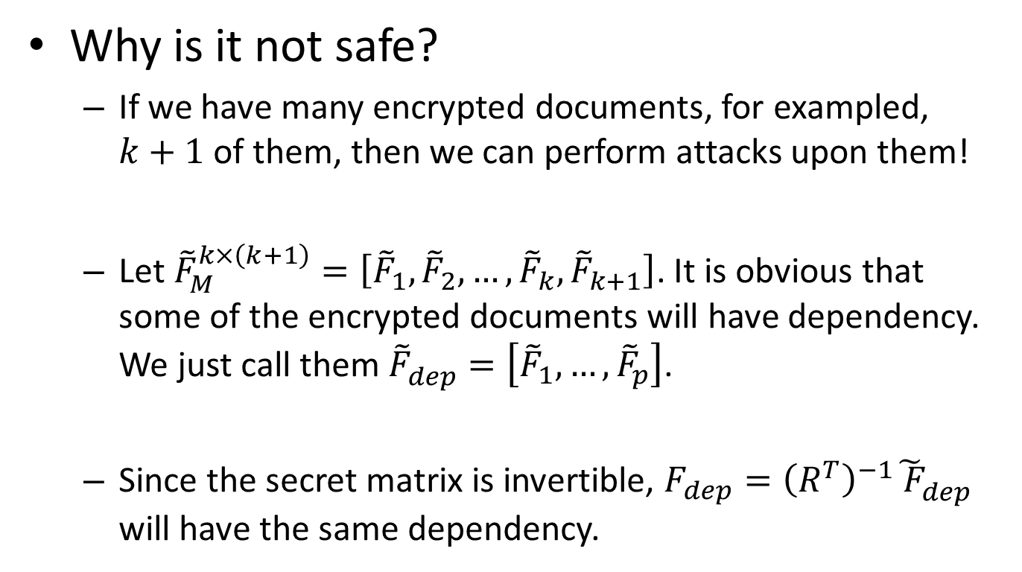
Intuitive method
Why is it not safe?
If we have many encrypted documents, for exampled, $k+1$ of them, then we can perform attacks upon them!
Let ${\tilde{F}}_{M}^{k×\left(k+1\right)}=\left[{\tilde{F}}_{1},{\tilde{F}}_{2},…,{\tilde{F}}_{k},{\tilde{F}}_{k+1}\right]$. It is obvious that some of the encrypted documents will have dependency. We just call them ${\tilde{F}}_{dep}^{}=\left[{\tilde{F}}_{1},…,{\tilde{F}}_{p}\right]$.
Since the secret matrix is invertible, $F_{dep}={\left(R_{}^{T}\right)}^{−1}{\tilde{ F}}_{dep}^{}$ will have the same dependency.

Slide 7
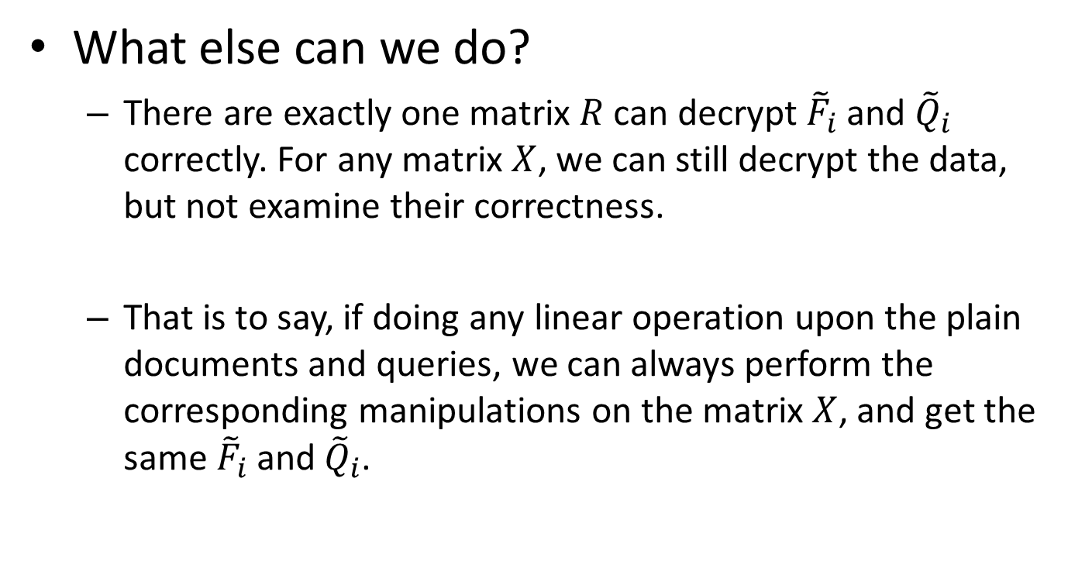
Intuitive method
What else can we do?
There are exactly one matrix $R$ can decrypt ${\tilde{F}}_{i}$ and ${\tilde{Q}}_{i}$ correctly. For any matrix $X$, we can still decrypt the data, but not examine their correctness.
That is to say, if doing any linear operation upon the plain documents and queries, we can always perform the corresponding manipulations on the matrix $X$, and get the same ${\tilde{F}}_{i}$ and ${\tilde{Q}}_{i}$.

Slide 8
Introduction to MRSE_I

Slide 9
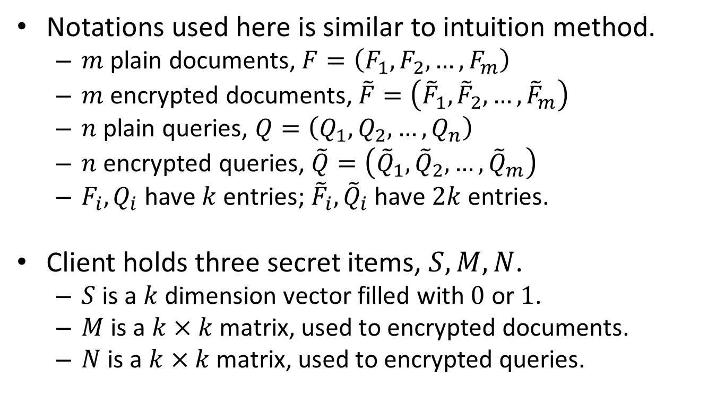
Introduction to MRSE_I
Notations used here is similar to intuition method.
$m$ plain documents, $F=\left(F_{1},F_{2},…,F_{m}\right)$
$m$ encrypted documents, $\tilde{F}=\left({\tilde{F}}_{1},{\tilde{F}}_{2},…,{\tilde{F}}_{m}\right)$
$n$ plain queries, $Q=\left(Q_{1},Q_{2},…,Q_{n}\right)$
$n$ encrypted queries, $\tilde{Q}=\left({\tilde{Q}}_{1},{\tilde{Q}}_{2},…,{\tilde{Q}}_{m}\right)$
$F_{i},Q_{i}$ have $k$ entries; ${\tilde{F}}_{i},{\tilde{Q}}_{i}$ have $2k$ entries.
Client holds three secret items, $S, M, N$.
$S$ is a $k$ dimension vector filled with $0$ or $1$.
$M$ is a $k×k$ matrix, used to encrypted documents.
$N$ is a $k×k$ matrix, used to encrypted queries.

Slide 10
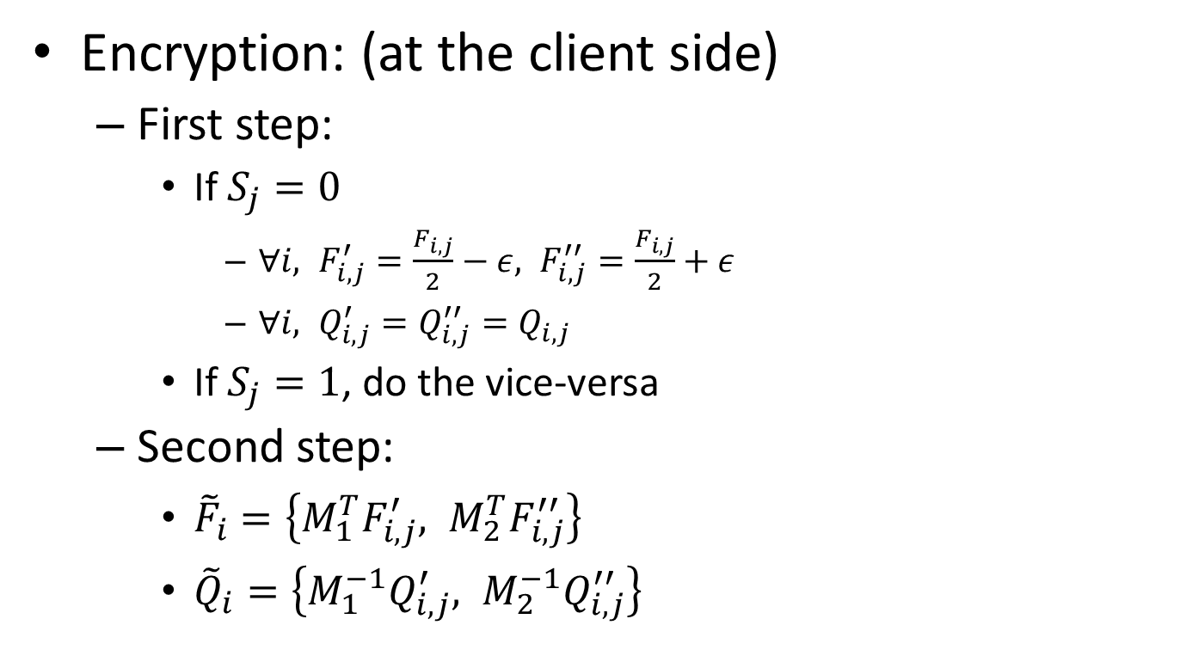
Introduction to MRSE_I
Encryption: (at the client side)
First step:
If $S_{j}=0$
$∀i, F_{i,j}^{′}=\frac{F_{i,j}}{2}−ε, F_{i, j}^{′′}=\frac{F_{i,j}}{2}+ε$
$∀i, Q_{i,j}^{′}=Q_{i,j}^{′′}=Q_{i,j}$
If $S_{j}=1$, do the vice-versa
Second step:
${\tilde{F}}_{i}=\left\{M_{1}^{T}F_{i,j}^{′}, M_{2}^{T}F_{i,j}^{′′}\right\}$
${\tilde{Q}}_{i}=\left\{M_{1}^{−1}Q_{i,j}^{′}, M_{2}^{−1}Q_{i,j}^{′′}\right\}$

Slide 11
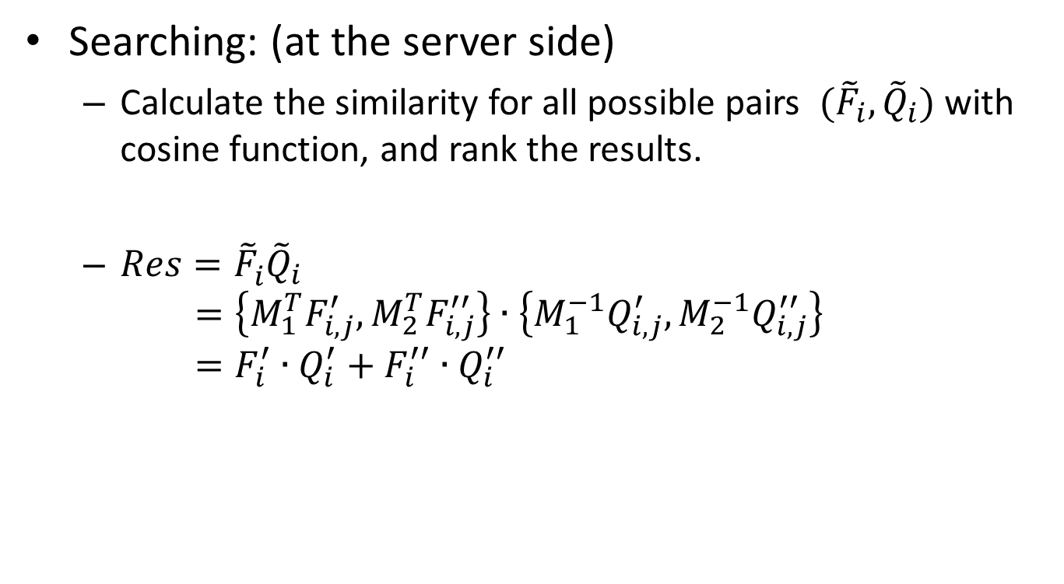
Introduction to MRSE_I
Searching: (at the server side)
Calculate the similarity for all possible pairs $({\tilde{F}}_{i},{\tilde{Q}}_{i})$ with cosine function, and rank the results.
$Res={\tilde{F}}_{i}^{}{\tilde{Q}}_{i}$ $=\left\{M_{1}^{T}F_{i,j}^{′}, M_{2}^{T}F_{i,j}^{′′}\right\}∙\left\{M_{1}^{−1}Q_{i,j}^{′}, M_{2}^{−1}Q_{i,j}^{′′}\right\}$ $=F_{i}^{′}∙Q_{i}^{′}+F_{i}^{′′}∙Q_{i}^{′′}$

Slide 12
Attack upon MRSE_I

Slide 13




What can we do?
]
MRSE_I
intuitive
$$F$$
$$(S,M,N)$$
$$R$$
$$Q$$
ATTACK!

Slide 14











First Defect
$$M$$
$$0$$
$$F′$$
$$0$$
$$N$$
$$F$$
$$S$$
$$\tilde{F}$$
$$F′′$$
$$S\left[j\right]=0 → F^{′}\left[j\right]+F^{′′}\left[j\right]=F\left[j\right]$$
$$→ dim+=2$$
$$S\left[j\right]=1 → F^{′}\left[j\right]=F^{′′}\left[j\right]=F\left[j\right]$$
$$→ dim+=1$$

Slide 15











First Defect
$$M$$
$$0$$
$$F′$$
$$0$$
$$0$$
$$N$$
$$1$$
$$F$$
$$S$$
$$\tilde{F}$$
$$F′′$$
$$S\left[j\right]=0 → F^{′}\left[j\right]+F^{′′}\left[j\right]=F\left[j\right]$$
$$S\left[j\right]=1 → F^{′}\left[j\right]=F^{′′}\left[j\right]=F\left[j\right]$$

Slide 16



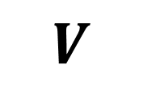









Second Defect
$$M$$
$$0$$
=
+
+
$$0$$
$$N$$
$$\tilde{F}$$
$$?$$
$$0$$
$$V$$
$$V∩\{ \}$$
$$V∩\{ \}$$
$$V∩{ }^{⊥}∩{ }^{⊥}$$
$$0$$
$$?$$

Slide 17






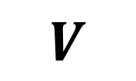





Overall Process
$$M$$
$$0$$
=
+
+
$$0$$
$$N$$
$$V$$
$$?$$
$$0$$
$$V∩\{ \}$$
$$V∩\{ \}$$
$$V∩{ }^{⊥}∩{ }^{⊥}$$
$$0$$
$$?$$
=
+
+

Slide 18
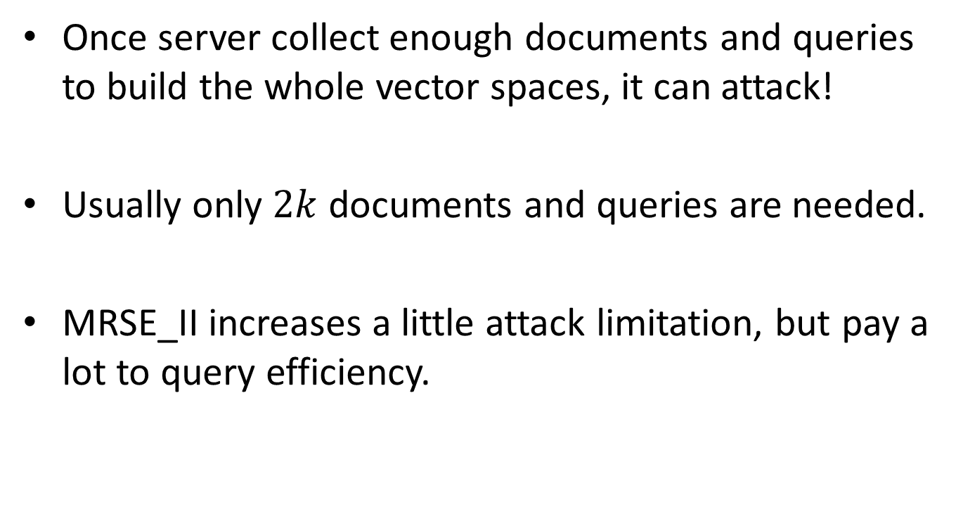
Analysis
Once server collect enough documents and queries to build the whole vector spaces, it can attack!
Usually only $2k$ documents and queries are needed.
MRSE_II increases a little attack limitation, but pay a lot to query efficiency.

Slide 19
Demo

Slide 20
Conclusion

Slide 21
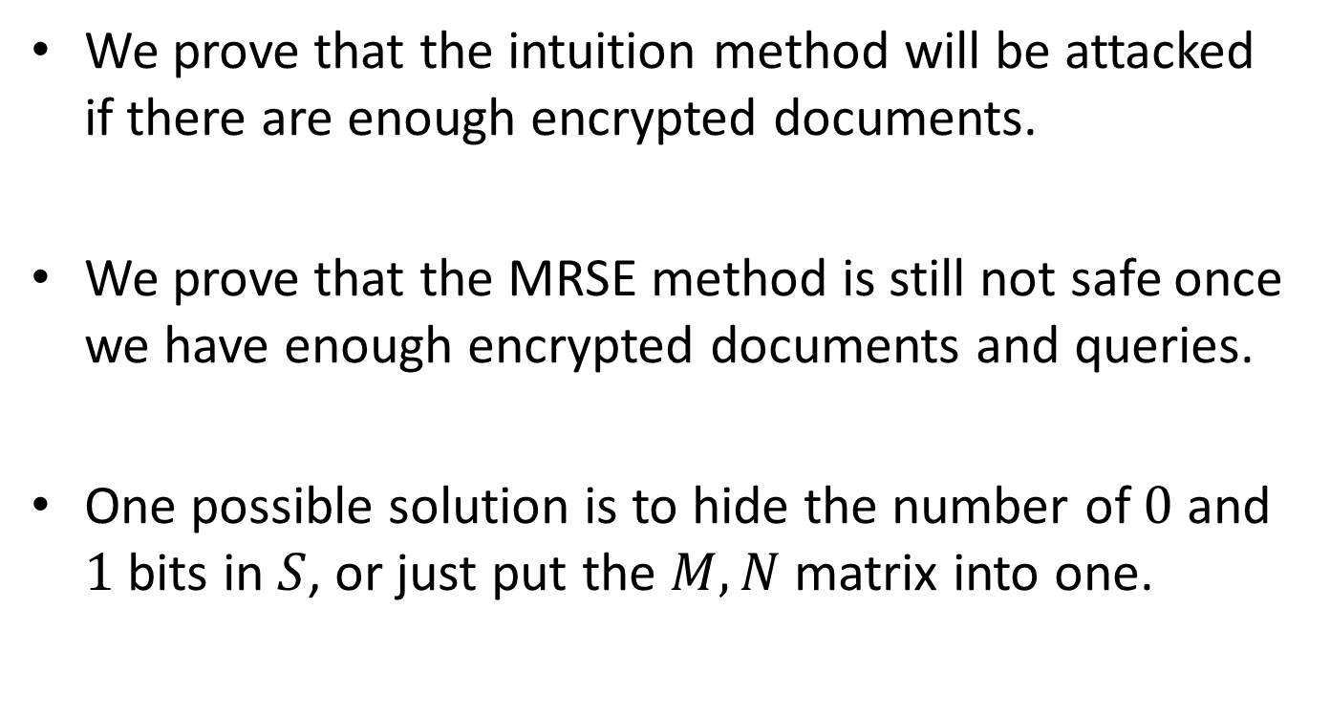
Conclusion
We prove that the intuition method will be attacked if there are enough encrypted documents.
We prove that the MRSE method is still not safe once we have enough encrypted documents and queries.
One possible solution is to hide the number of $0$ and $1$ bits in $S$, or just put the $M, N$ matrix into one.

